Slide 1
Psychopathology
Week 1

Slide 2

Program Check-in

Slide 3
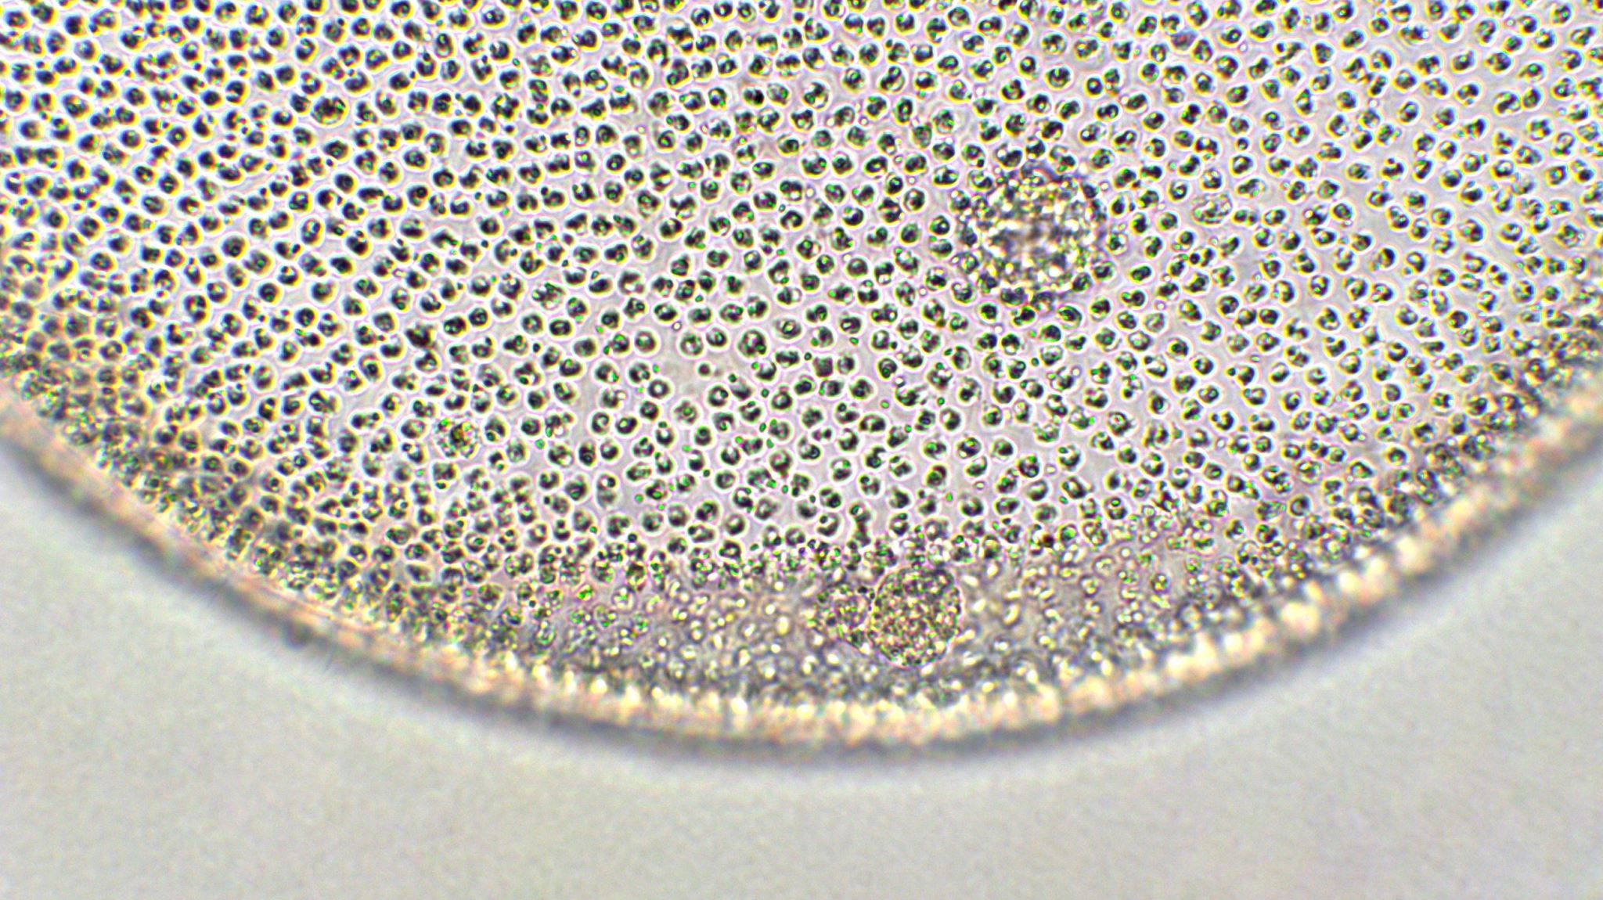
Syllabus…

Slide 4
In this Class…
Learning Community
Participation and Engagement Critical
Blend of Socratic and Didactic
Discussing Challenging Topics

Slide 5

Understanding Our Own View of Psychopathology
Reflect on your views, beliefs and values with regard to Psychopathology
How do you define psychopathology, mental illness?
What causes mental illness?
How do I view those who experience mental disorders?
How does the dominate culture view mental health and mental illness?
Can mental illness be “cured” ?
Other…

Slide 6
Some Reflections and Encouragements
The study of psychopathology can be interesting, and exciting- and confusing. Be open to the Journey
It will change your lens of the world
- Resist diagnosing yourself or those you know
-Resist over pathologizing
-Be sensitive to the experience of others and yourself

Slide 7
Getting Started
What is Psychopathology?
Why do we study Psychopathology?
What questions, concerns, fears, apprehensions do you have about the process of diagnosis?

Slide 8
Defining Mental Disorders
Inability of internal mechanism to perform natural function
Condition that causes harm- based judgement of culture results in subjective distress
(Wakefield 2010 as cited in Castonguay, Oltmanns, & Lott 2021)
APA (2022) Definition-
A syndrome characterized by clinically significant disturbance in cognition, emotion regulation, or behavior
Dysfunction in psychological, biological or developmental processes
Cause distress or disability in social, occupational, or other areas
(Castonguay, Oltmanns, & Lott 2021)

Slide 9
The DSM
What is the DSM and how does it work?
A categorical classification system of mental disorders based on criteria (Widiger & Gore, 2014)
What are the benefits of using a diagnostic system like the DSM?
What are some challenges of using a diagnostic system like the DSM?

Slide 10
The DSM
Discrete disorders or arbitrary distinctions
Changes to DSM 5 attempt to address this issue
Move to continuum model for some disorders (i.e. autism related disorders)
Collapse of some subtypes of schizophrenia into one continuum
However, still largely categorical
(Widiger & Gore, 2014)

Slide 11
DSM- Challenges Continued
Boundary between normal and abnormal behavior
DSM descriptions of thresholds are vague
Limited definition of social impairment also a challenge
What does this mean for us?
(Castonguay, Oltmanns, & Lott 2021)

Slide 12
How to Use the DSM
It is a resource and reference manual
Refer to rather than memorize
Know how to find what you are looking for
Be thorough and systematic
Read the introduction and Use of Manual sections

Slide 13
Using the DSM
Important to understand that the DSM is a manual, but we are the clinician
Diagnosis are not reached by a checklist of symptoms but relay on clinical judgment to understand history, severity, cultural factors, biological factors etc.
Definitions are not exhaustive but representative
Experience with symptoms can be individual

Slide 14
Clinical Significance
How is clinical Significance Determined?
Subjective reports
Clinical Observation and Judgment
Reports by family or friends
Symptoms may be significant but not pathological
Below threshold of duration, intensity, frequency, distress
(APA, 2022)

Slide 15
Criteria, Features, and Specifiers
Criteria are guidelines that require clinical judgement to apply and understand
Diagnostic Features- Narrative description of symptoms and criteria
Subtype and Specifiers
Whether vs. If
Subtype- mutually exclusive designations within a disorder
Specifiers are descriptors of additional features, severity
(APA, 2022)

Slide 16
Principle and Provisional Diagnosis
Principle diagnosis
Related to the presenting issue for out-patient settings
Related to the reason for admission for in-patient settings
Sometimes difficult to determine which issue is primary
Provisional
Full criteria not met- Almost there but not quite
Not enough information available
Duration of symptom(s) does not meet criteria- Acute stress vs PTSD
Specified vs. unspecified
(APA, 2022)

Slide 17
An Approach to using the DSM
What is the presenting issue
What category do symptoms fall into
Review Diagnostic Features
Do symptoms fit?
Diagnostic Criteria
Systematically verify if FULL criteria is met
Differential Diagnosis
Could this be better identified as…
Systematically consider other disorders by repeating process above

Slide 18
Providing a Diagnosis
Clinical Utility- Prognosis and treatment
Complex, multifaceted, individual, culturally bound
Lack of diagnosis does not mean no need for treatment
More than one diagnosis- Comorbidity
Primary diagnosis is the focus of treatment
List others in order of treatment plan
May be provisional
Person Centered vs Disorder Centered Language
(APA, 2022)

Slide 19
How to Collect Data for a Diagnosis
Intake Forms and Questionnaires
Clinical Interviewing and observation
DSM 5 Crosscutting Tools
Previous Records-Medical and other
Subjective reports from others (when appropriate)

Slide 20
Depressive Disorders
Sad, irritable, and cognitive changes
Addition of Disruptive Mood Dysregulation Disorder
Avoid over diagnosis of Bipolar in children
Differs from grief, “normal” sadness and mood changes
(APA, 2022)

Slide 21
Disruptive Mood Dysregulation
Persistent and frequent irritability and aggression
Temper outbursts and chronic irritability
Aggression is more than what would be considered appropriate to situation
Onset before age 10
Must rule out development disorders
Differs from bipolar based on lack of shift from depression and irritable mood
DMD does not typical shift to bipolar, but to depression and anxiety
(APA, 2022)

Slide 22
Major Depressive Disorder
Low mood and loss of interest in ALL or Almost ALL activities
Disturbances
sleep, appetite, psychomotor activity
Feelings of guilt, hopelessness, suicidal ideation
Fatigue and decreased energy, concertation issues
Agitation and Irritability
Specifiers
(APA, 2022)

Slide 23
Persistent and Premenstrual Dysphoric Disorders
Persistent Depressive Disorder
May occur after MD episode and MD symptoms may continue
2 year period of symptoms
Premenstrual Dysphoric Disorder
Mood changes, anxiety and irritability that are beyond typical experience
Start before menses and subside within a week follow end of menses
Cause clinical significant distress
(APA, 2022)

Slide 24
To Diagnose or Not to Diagnose…
When do we diagnose?
When would we not provide a diagnosis?
Ethical, moral and other considerations…

